Slide 1
73rd Annual Orlando HamCation (started in 1945)
ARRL Southeastern Division Convention
Central Florida Fairgrounds
Orlando, Florida
February 8, 9, 10, 2019

Slide 2
What are the four largest annual ham gatherings worldwide?
JARL Tokyo Ham Fair (39,000 in 2018)
Dayton Hamvention (28,417 in 2018)
Orlando HamCation (23,000 est in 2019)
Ham Radio, Friedrichshafen, Germany (15,460 in 2018)

Slide 3
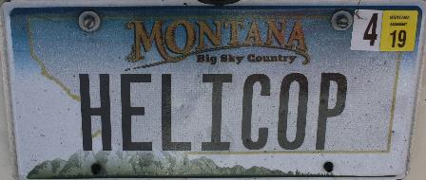
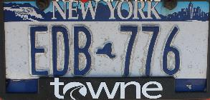
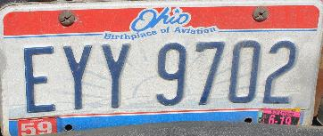
Not just the Southeast

Slide 4
Why Attend?
Orlando in February, what’s not to love?

Slide 5
Why Attend?
Orlando in February, what’s not to love?
Cheap flights from TYS ($80) or short (9 hour) car ride to haul all your loot home

Slide 6
Why Attend?
Orlando in February, what’s not to love?
Cheap flights from TYS ($80) or short (9 hour) car ride to haul all your loot home
Plenty of other attractions in Orlando area – makes a great mini-vacation for the family

Slide 7
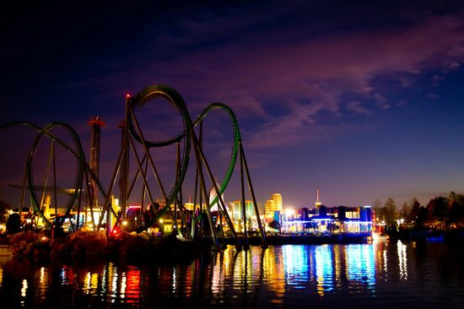
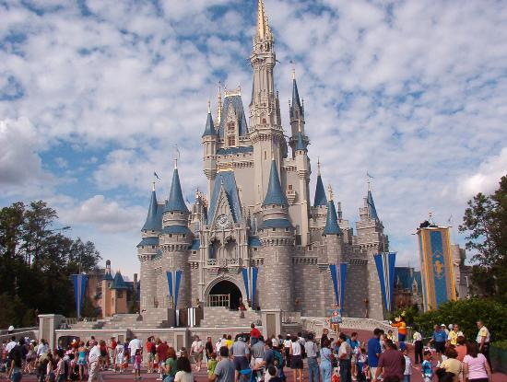
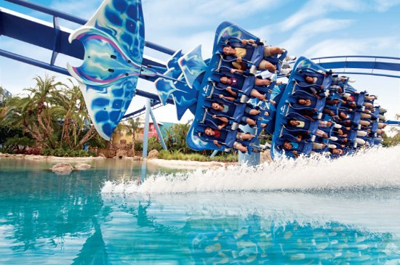
Opportunities to lighten your wallet

Slide 8
Why Attend?
Orlando in February, what’s not to love?
Cheap flights from TYS ($80) or short (9 hour) car ride to haul all your loot home
Plenty of other attractions in Orlando area – makes a great mini-vacation for the family
Over 100 vendors – pretty much everyone you’re looking for is there

Slide 9
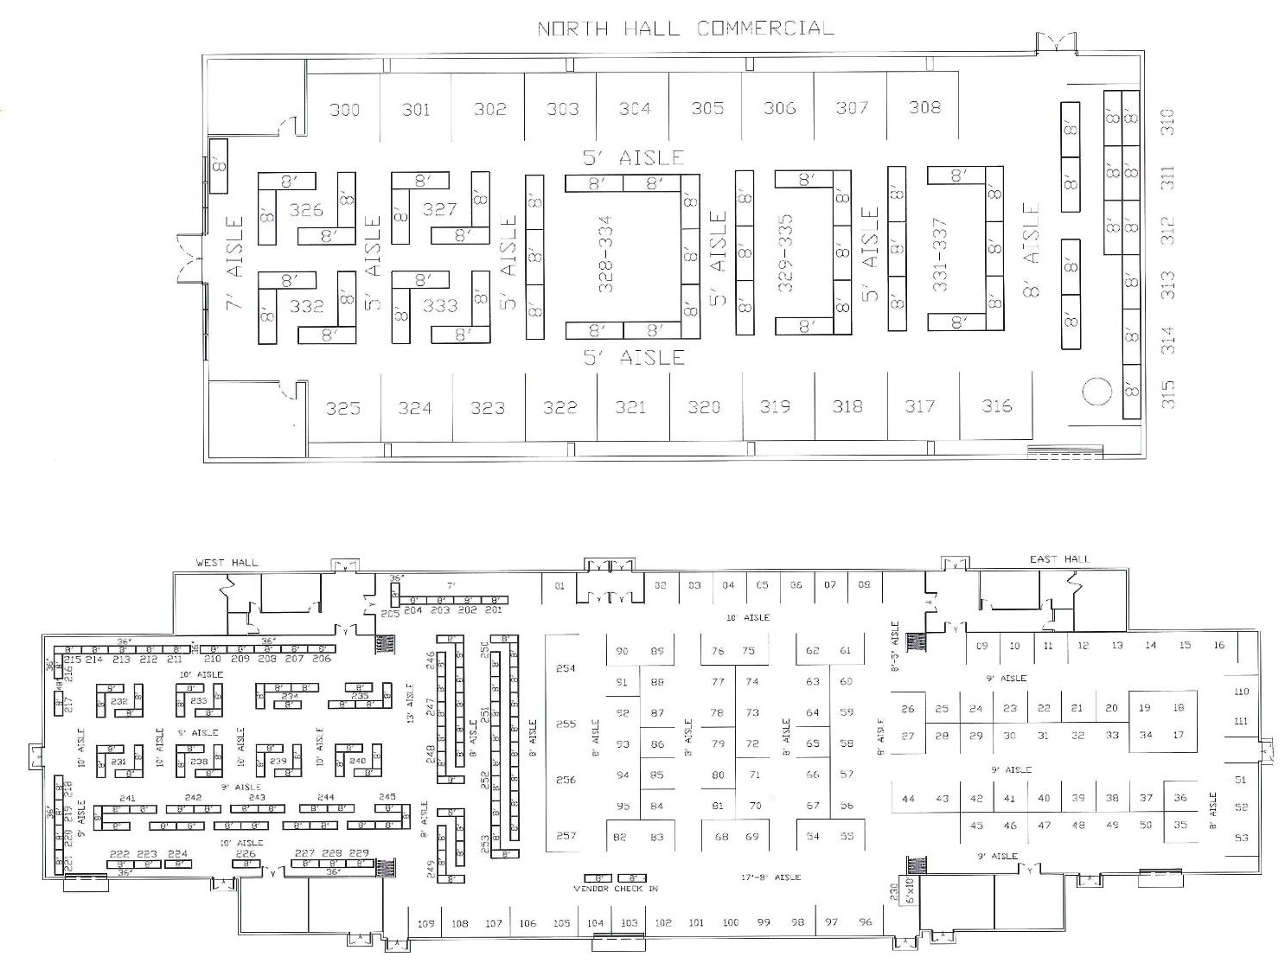
89 Vendors in three main buildings

Slide 10
Why Attend?
Orlando in February, what’s not to love?
Cheap flights from TYS ($80) or short (9 hour) car ride to haul all your loot home
Plenty of other attractions in Orlando area – makes a great mini-vacation for the family
Over 100 vendors – pretty much everyone you’re looking for is there
Plenty of parking; easy access; expansive site

Slide 11
Central Florida Fairgrounds

Slide 12
Why Attend?
Large Forums
3 Clearspan tents each with a capacity of 150 people, air conditioned
37 Forums on large variety of topics over Friday and Saturday

Slide 16
Why Attend?
Large Forums
3 Clearspan tents each with a capacity of 150 people, air conditioned
37 Forums on large variety of topics over Friday and Saturday
Indoor and outdoor flea markets

Slide 17
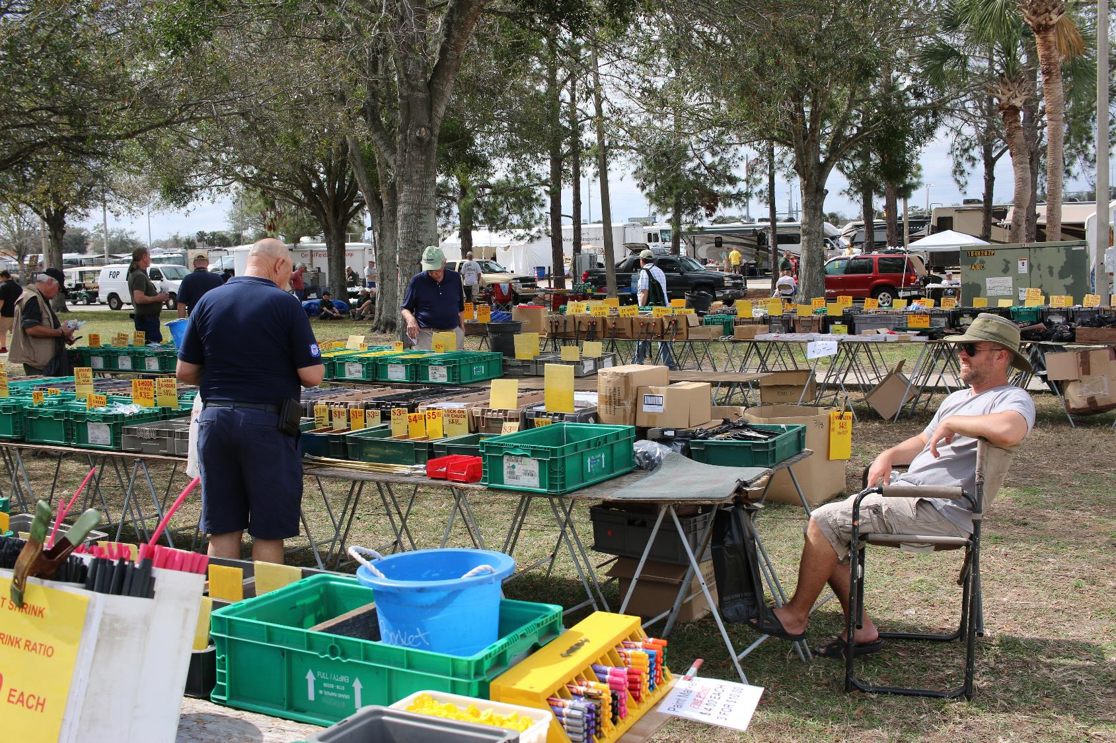

Slide 19
Why Attend?
Large Forums
3 Clearspan tents each with a capacity of 150 people, air conditioned
37 Forums on large variety of topics over Friday and Saturday
Indoor and outdoor flea markets
Lots of door prizes

Slide 20
$25,000 Worth of Door Prizes

Slide 21
Hourly Prize List
Yaesu FT2 DR Zum Spot with case Alinco DJ-G7T Kenwood TS-480 SAT Yaesu FT-891 Powerpole Bag Alinco DX-SR8T Yaesu FTM-400 Zum Spot with case Alinco DM-430T Daiwa SS-330W
Icom ID-51A Plus2 Icom IC-7200 Alinco DJ-500T Yaesu FT-857D Zum Spot with case Yaesu FT-450D Daiwa SS-330W Icom ID-5100 Comet CAA-500 Mark II Powerpole Bag Yaesu FT-60
Icom ID-31A Plus Alinco MD5TGP Kenwood D-710 Yaesu FT-818 Icom IC-7100 Zum Spot with case Yaesu FT-70DR Zum Spot with case Icom IC-718 Kenwood TH-D72A Alinco DM-430T

Slide 22
Grand Prize List

Slide 23
Why Attend?
Large Forums
3 Clearspan tents each with a capacity of 150 people, air conditioned
37 Forums on large variety of topics over Friday and Saturday
Indoor and outdoor flea markets
Lots of door prizes
Stuff you wouldn’t expect

Slide 25
Why Attend?
Large Forums
3 Clearspan tents each with a capacity of 150 people, air conditioned
37 Forums on large variety of topics over Friday and Saturday
Indoor and outdoor flea markets
Lots of door prizes
Stuff you wouldn’t expect
Test gear

Slide 27
Why Attend?
Large Forums
3 Clearspan tents each with a capacity of 150 people, air conditioned
37 Forums on large variety of topics over Friday and Saturday
Indoor and outdoor flea markets
Lots of door prizes
Stuff you wouldn’t expect
Test gear
Unique displays

Slide 30
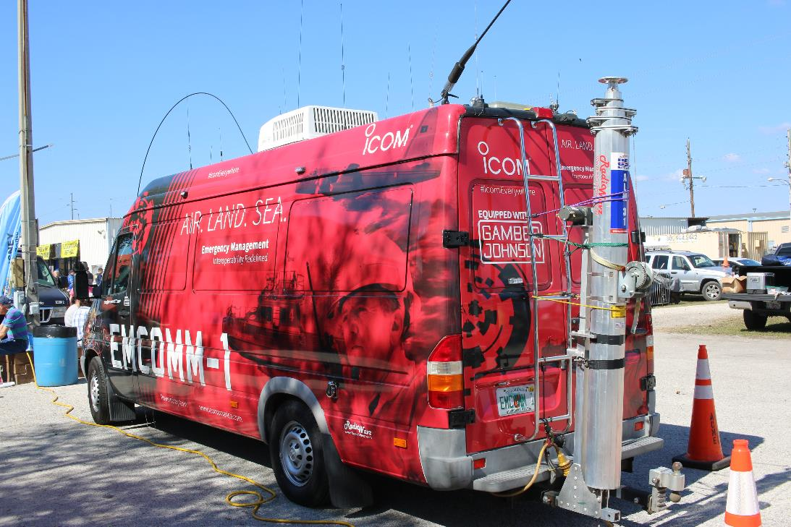

Slide 32
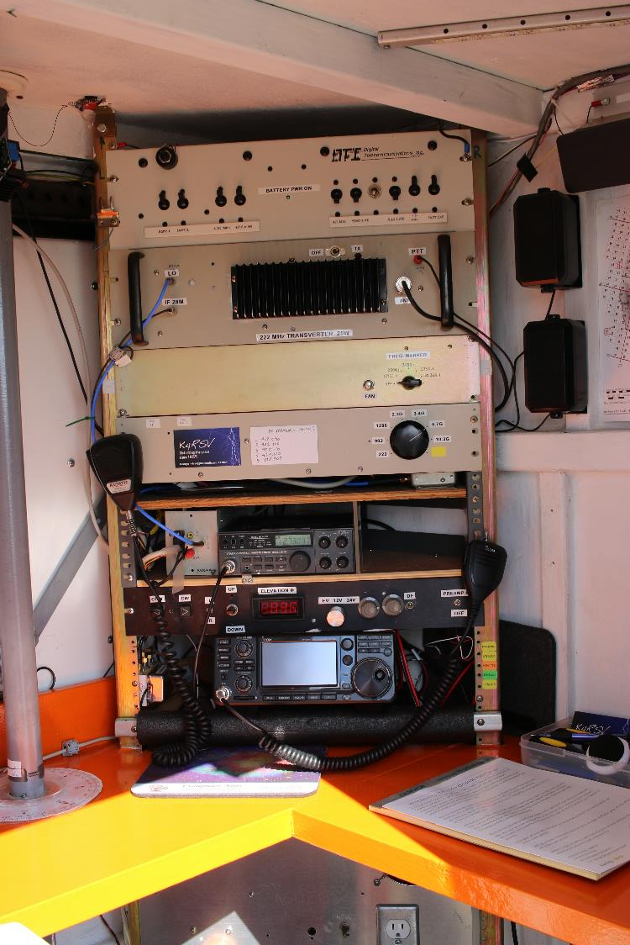

Slide 33
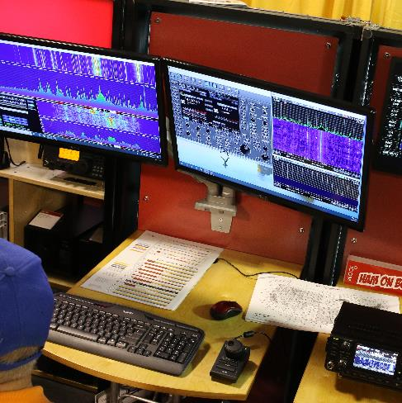
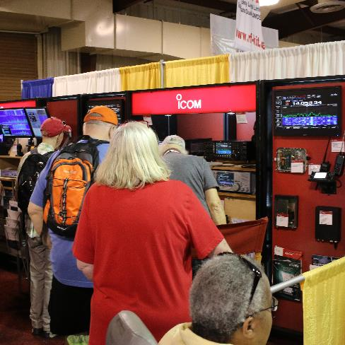
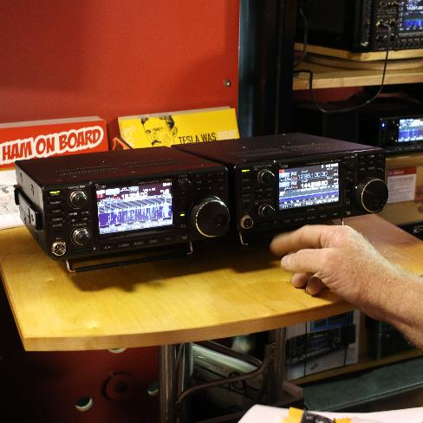
Major Vendor Displays Icom

Slide 34
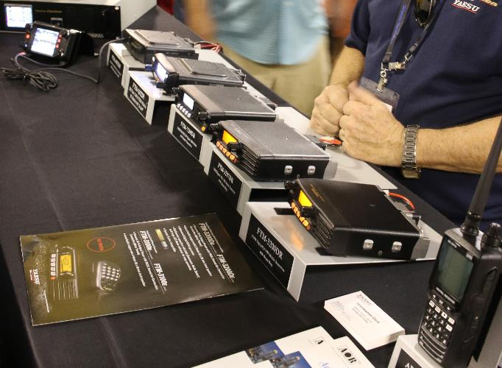
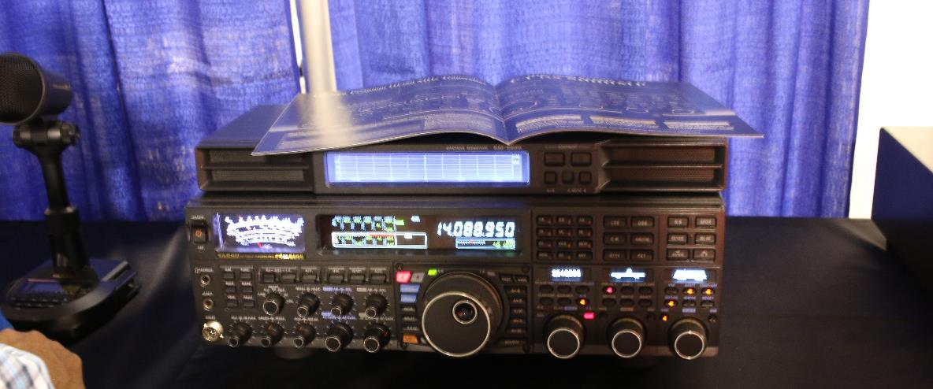
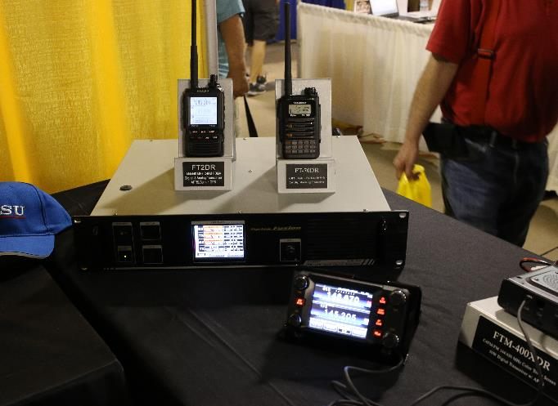
Major Vendor Displays Yaesu

Slide 35
Major Vendor Displays Kenwood

Slide 36
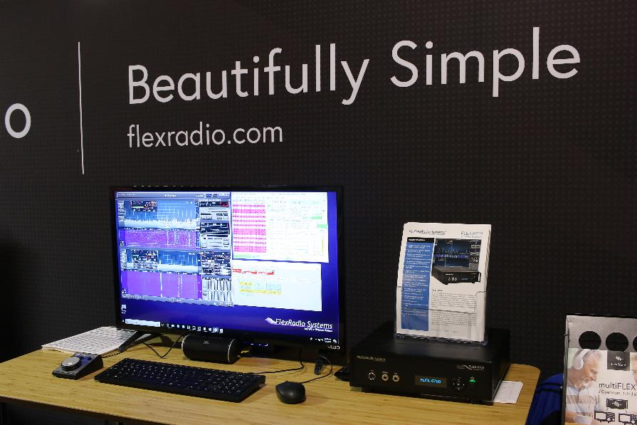
Major Vendor Display Flex Radio

Slide 37
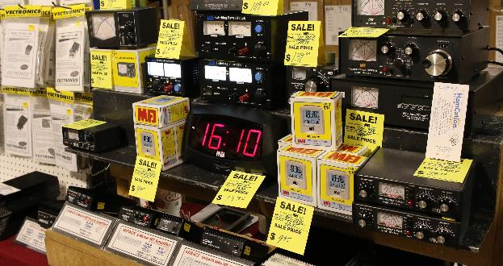
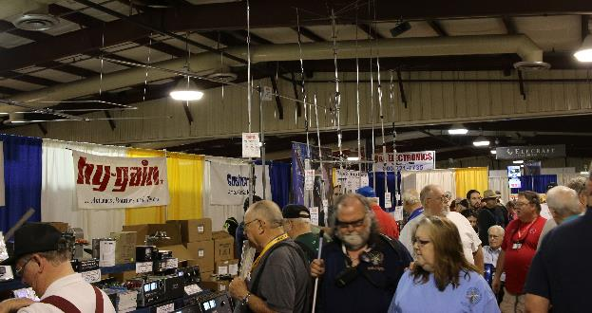
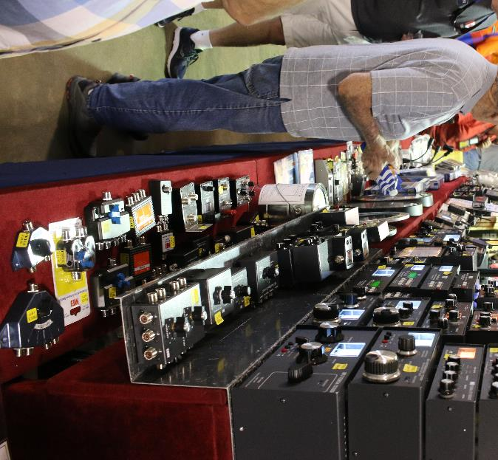
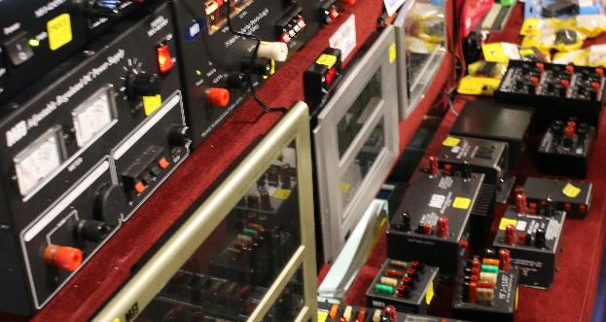
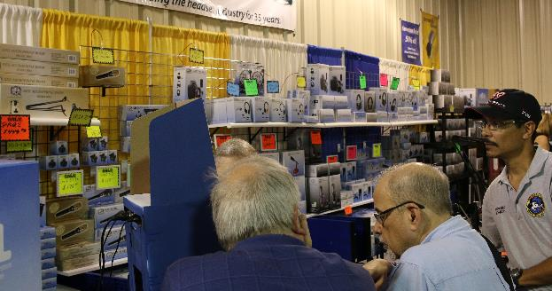
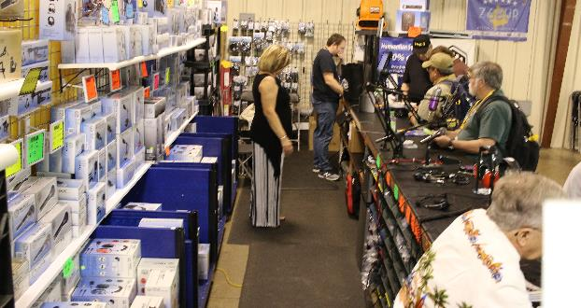
Other Notable Vendors

Slide 38
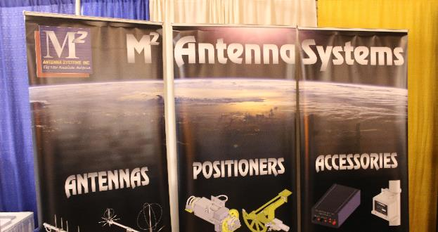
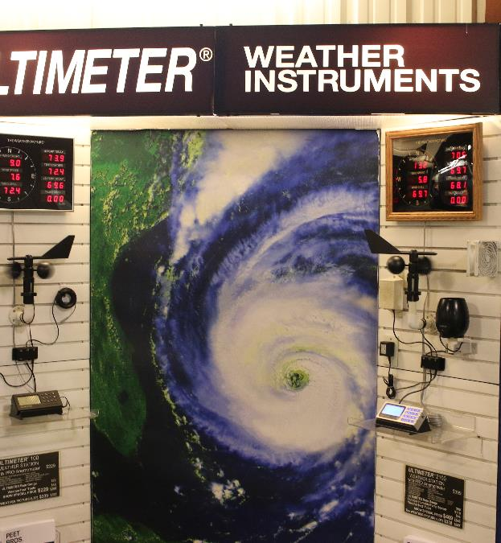
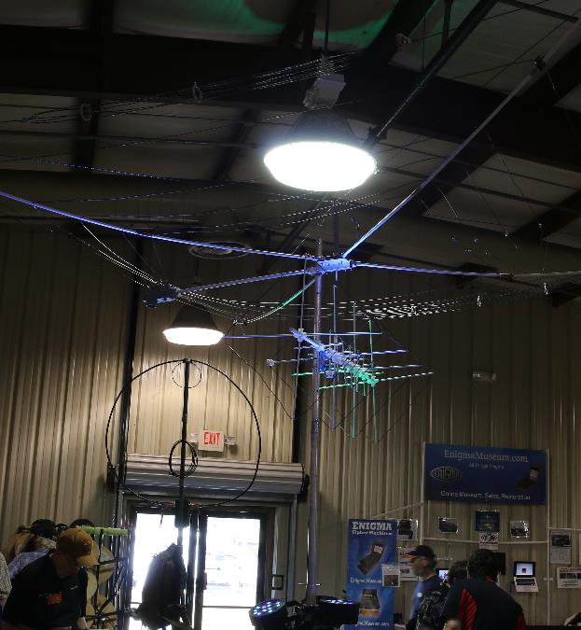
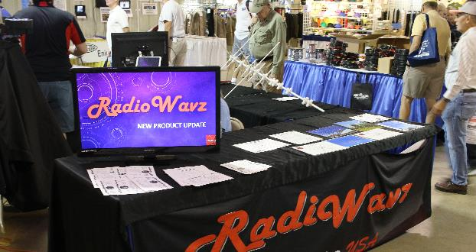
Other Notable Vendors

Slide 39
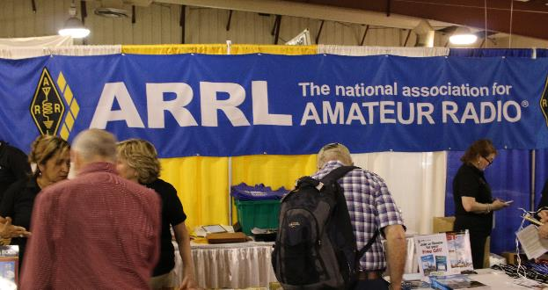
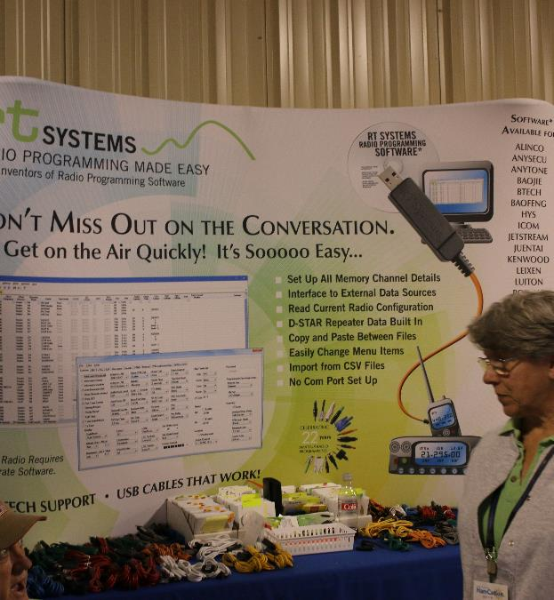
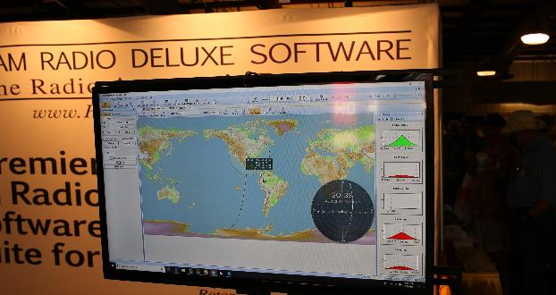
Other Notable Vendors

Slide 40
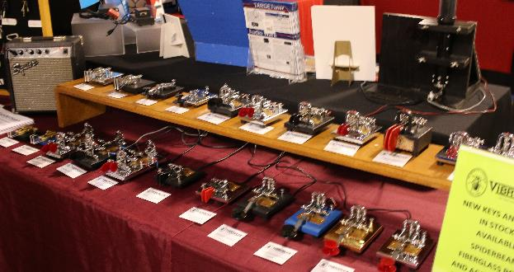
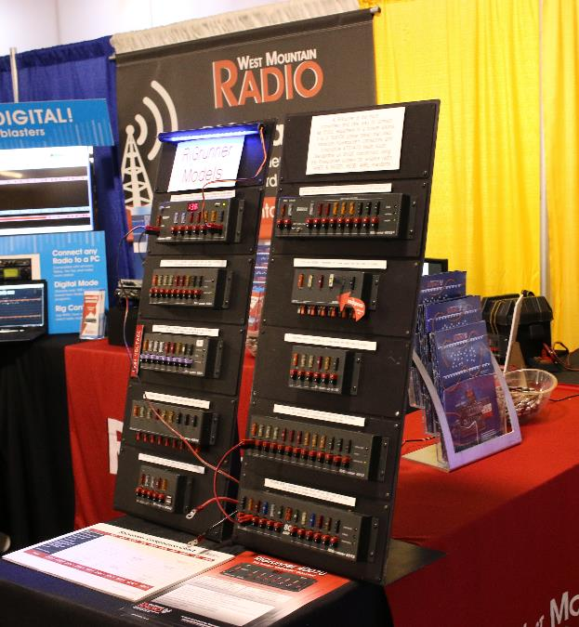
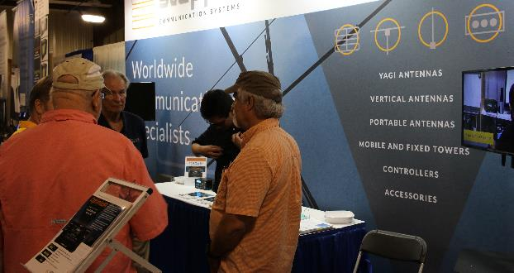
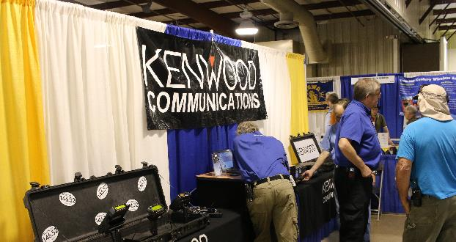
Other Notable Vendors

Slide 41
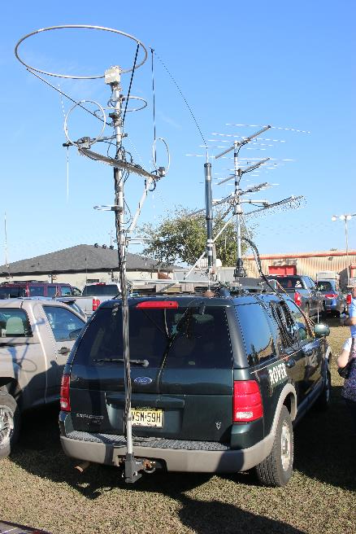
Meanwhile, back in the parking lot…

Slide 43
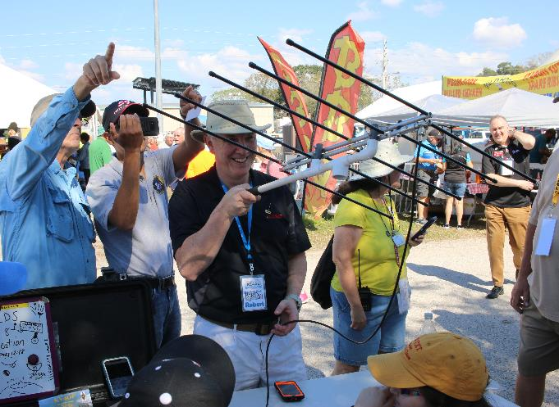
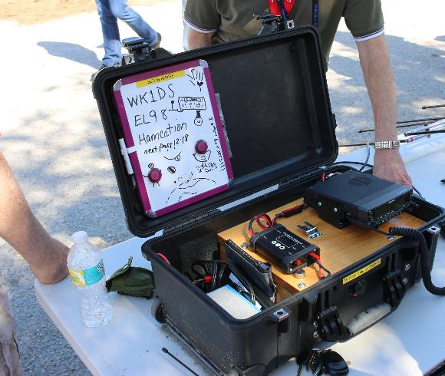
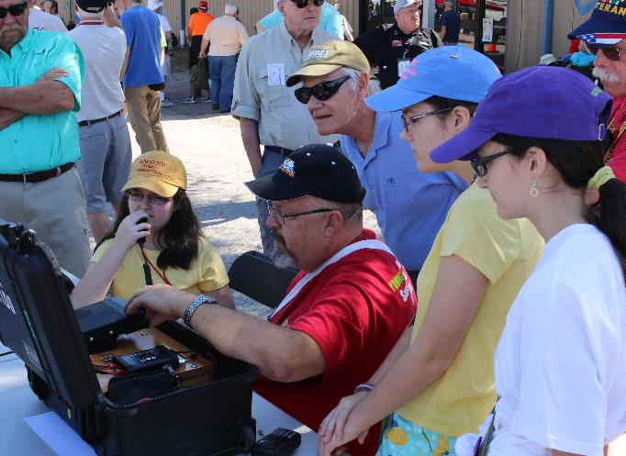
WK1DS Satellite Demo

Slide 44
Grace Lea, KM4TXT
Grace received her Tech license at age 8
Made General at age 9
Made Extra on February 10th at age 11

Slide 45
The Lea Family
James (Dad) WX4TV – Extra
Michelle (Mom) N8ZQZ – General
Zechariah WX4TVJ – Extra
Faith Hannah AE4FX – Extra
Hope KM4IPF – Extra
Grace KM4TXT – Extra – passed her exam at HamCation on February 10th!!

Slide 47
HamCation 2020
February 7-9, 2020
Central Florida Fairgrounds, Orlando, FL
www.hamcation.org

Slide 48
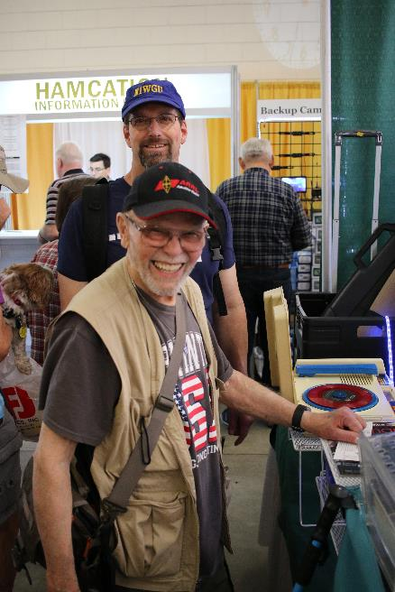
In Memory of K1KU Darrel Daley, SK Dec 16, 2018

